Slide 1

Chiba Campaign 2019
November 18-December 2, 2019
~${\text{PM}}_{2.5}$ and Black Carbon ~
Department of Earth Science, Faculty of Science Takeru Ohno

Slide 2
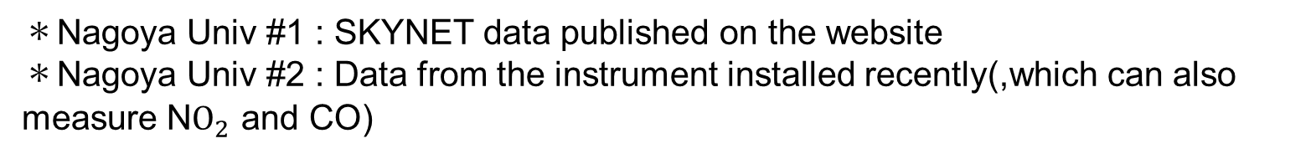
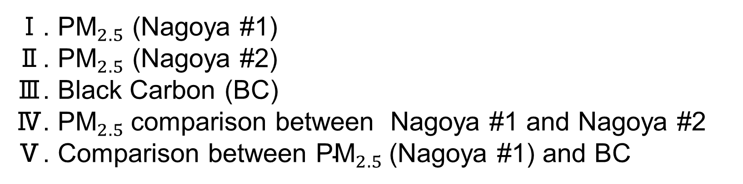
Index
Ⅰ. ${\text{PM}}_{2.5}$ (Nagoya #1)
Ⅱ. ${\text{PM}}_{2.5}$ (Nagoya #2)
Ⅲ. Black Carbon (BC)
Ⅳ. ${\text{PM}}_{2.5}$comparison between Nagoya #1 and Nagoya #2
Ⅴ. Comparison between ${\text{PM}}_{2.5}$(Nagoya #1) and BC
＊Nagoya Univ #1 : SKYNET data published on the website
＊Nagoya Univ #2 : Data from the instrument installed recently(,which can also measure ${\text{N}O}_{2}$ and CO)

Slide 3
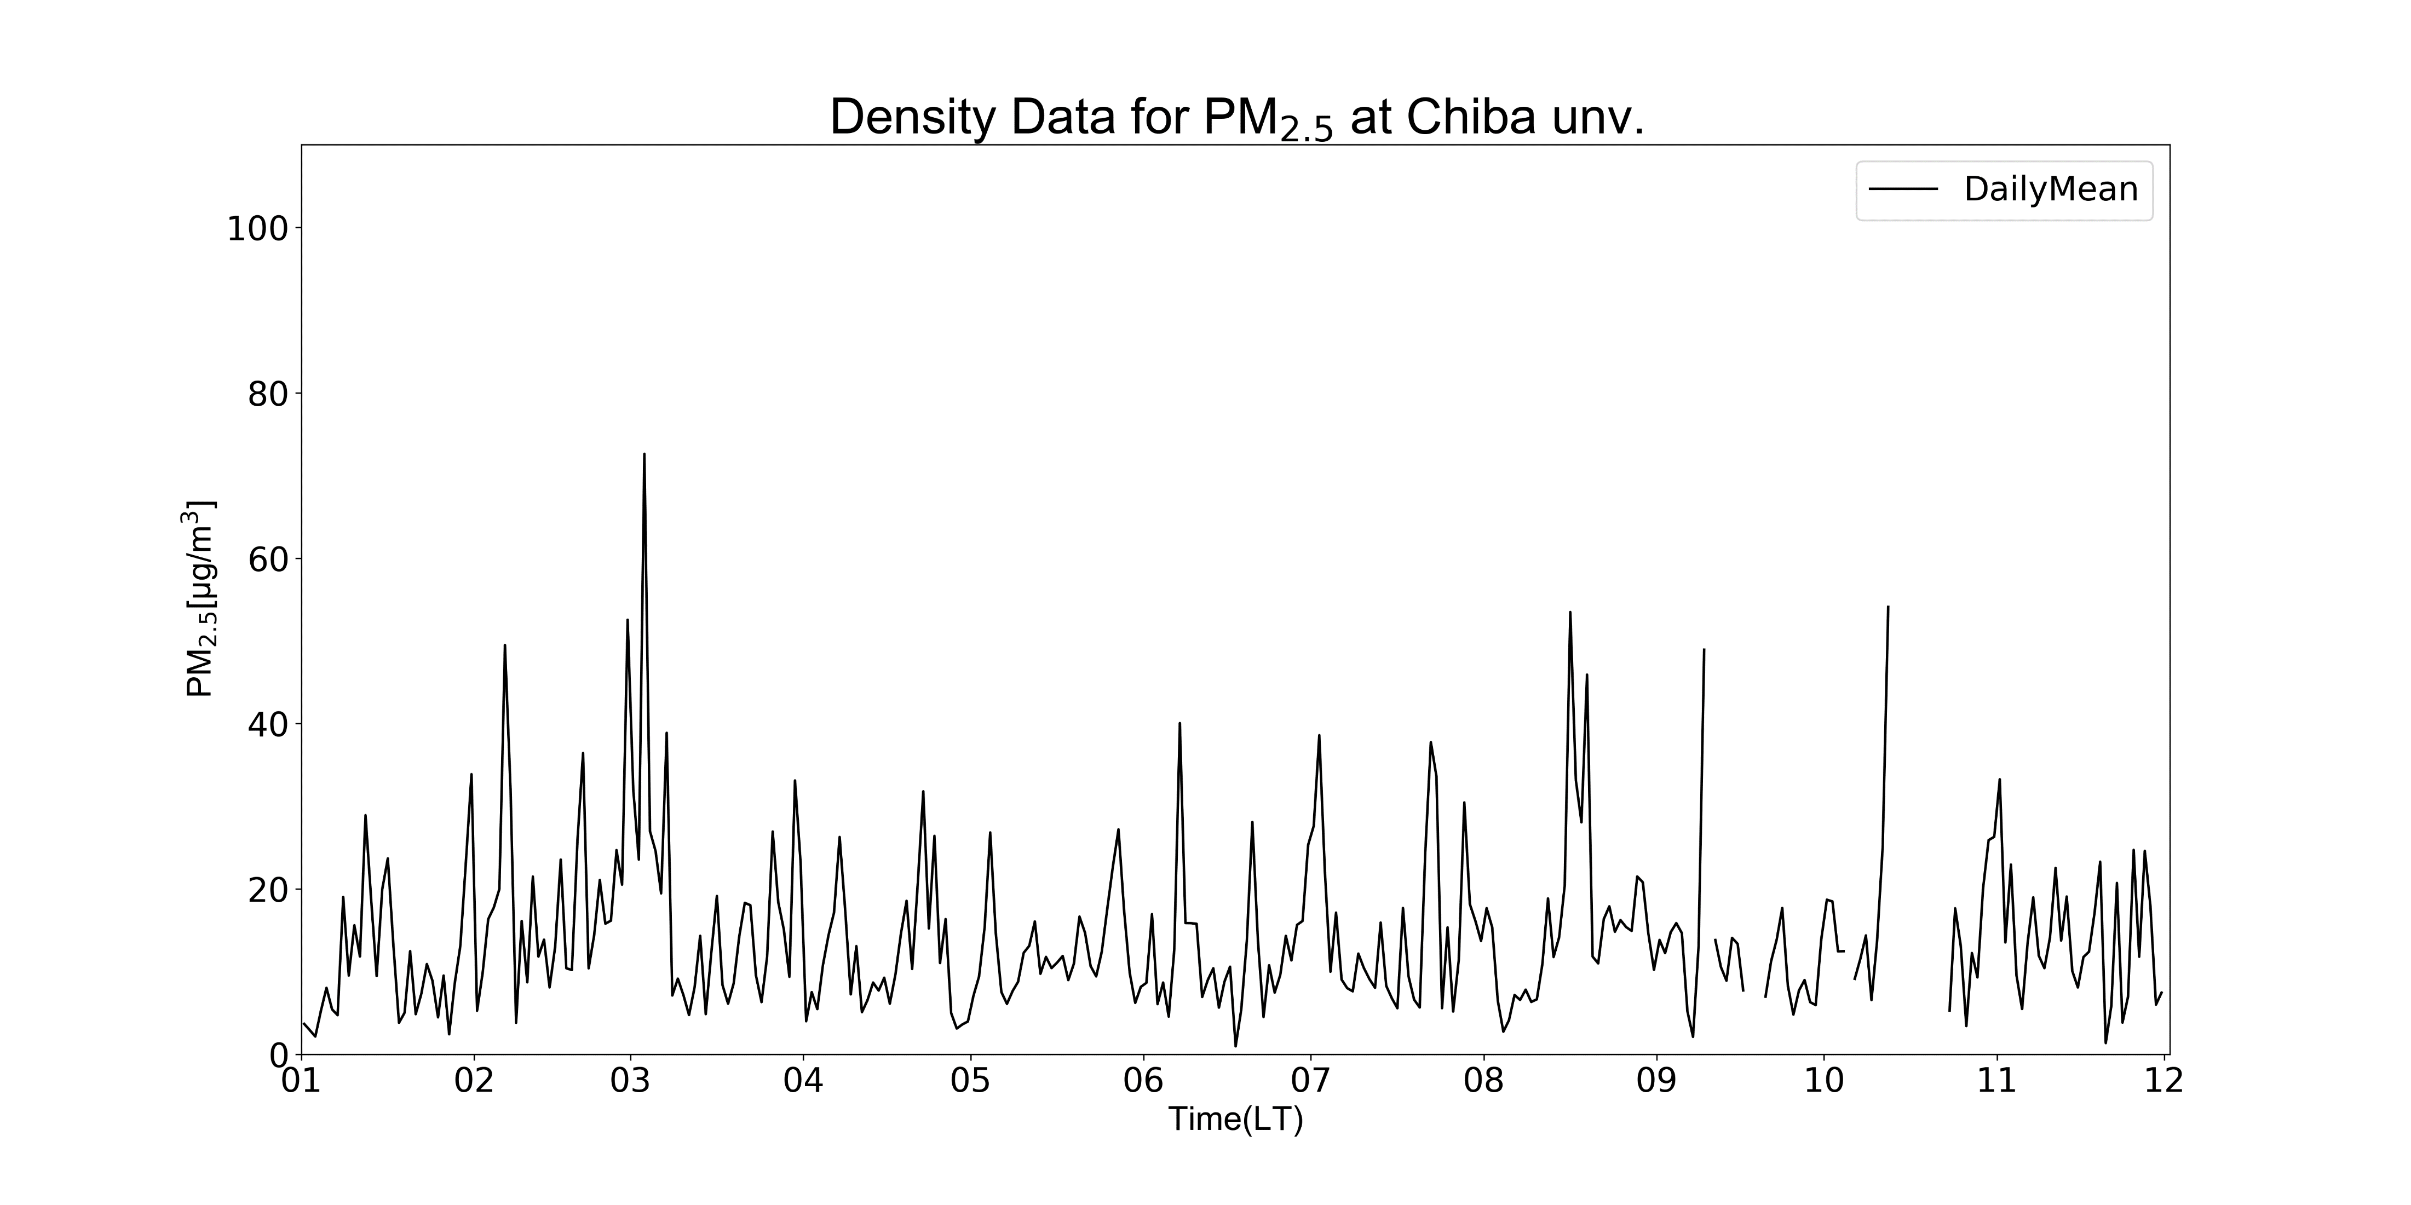
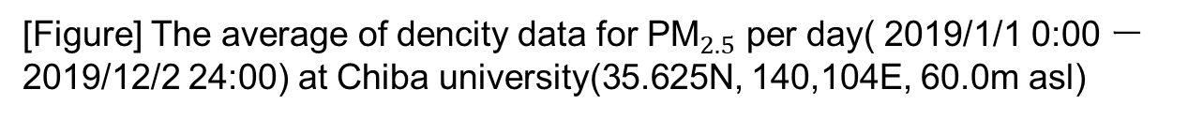
Ⅰ
[Figure] The average of dencity data for ${\text{PM}}_{2.5}$ per day( 2019/1/1 0:00 ー 2019/12/2 24:00) at Chiba university(35.625N, 140,104E, 60.0m asl)

Slide 4
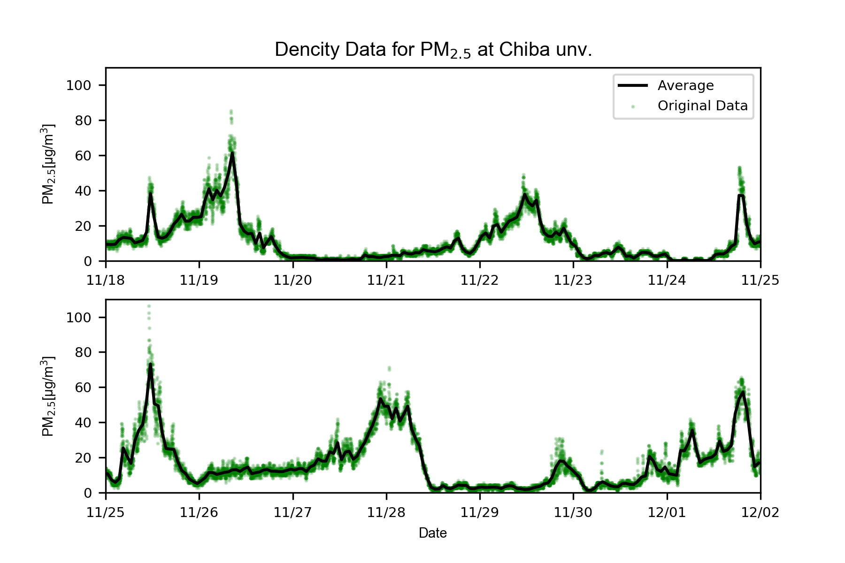
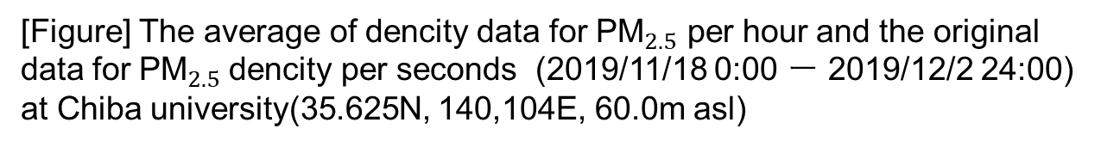
Ⅰ
[Figure] The average of dencity data for ${\text{PM}}_{2.5}$ per hour and the original data for ${\text{PM}}_{2.5}$dencity per seconds (2019/11/18 0:00 ー 2019/12/2 24:00) at Chiba university(35.625N, 140,104E, 60.0m asl)

Slide 5
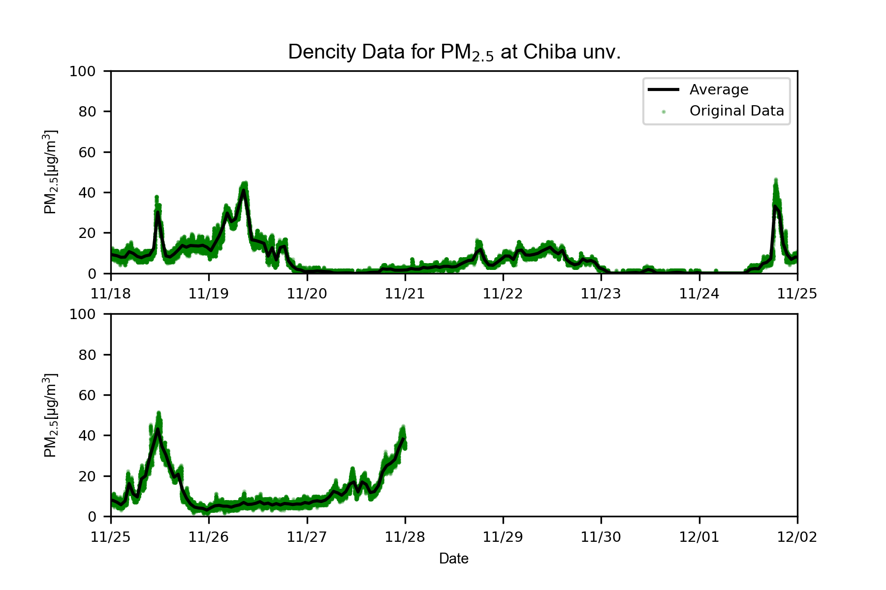
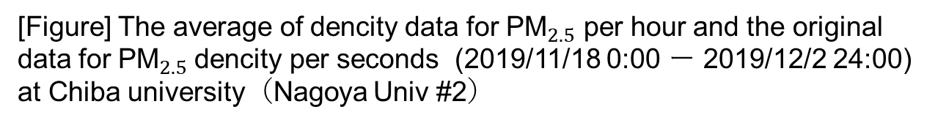
Ⅱ
[Figure] The average of dencity data for ${\text{PM}}_{2.5}$ per hour and the original data for ${\text{PM}}_{2.5}$dencity per seconds (2019/11/18 0:00 ー 2019/12/2 24:00) at Chiba university（Nagoya Univ #2）

Slide 6
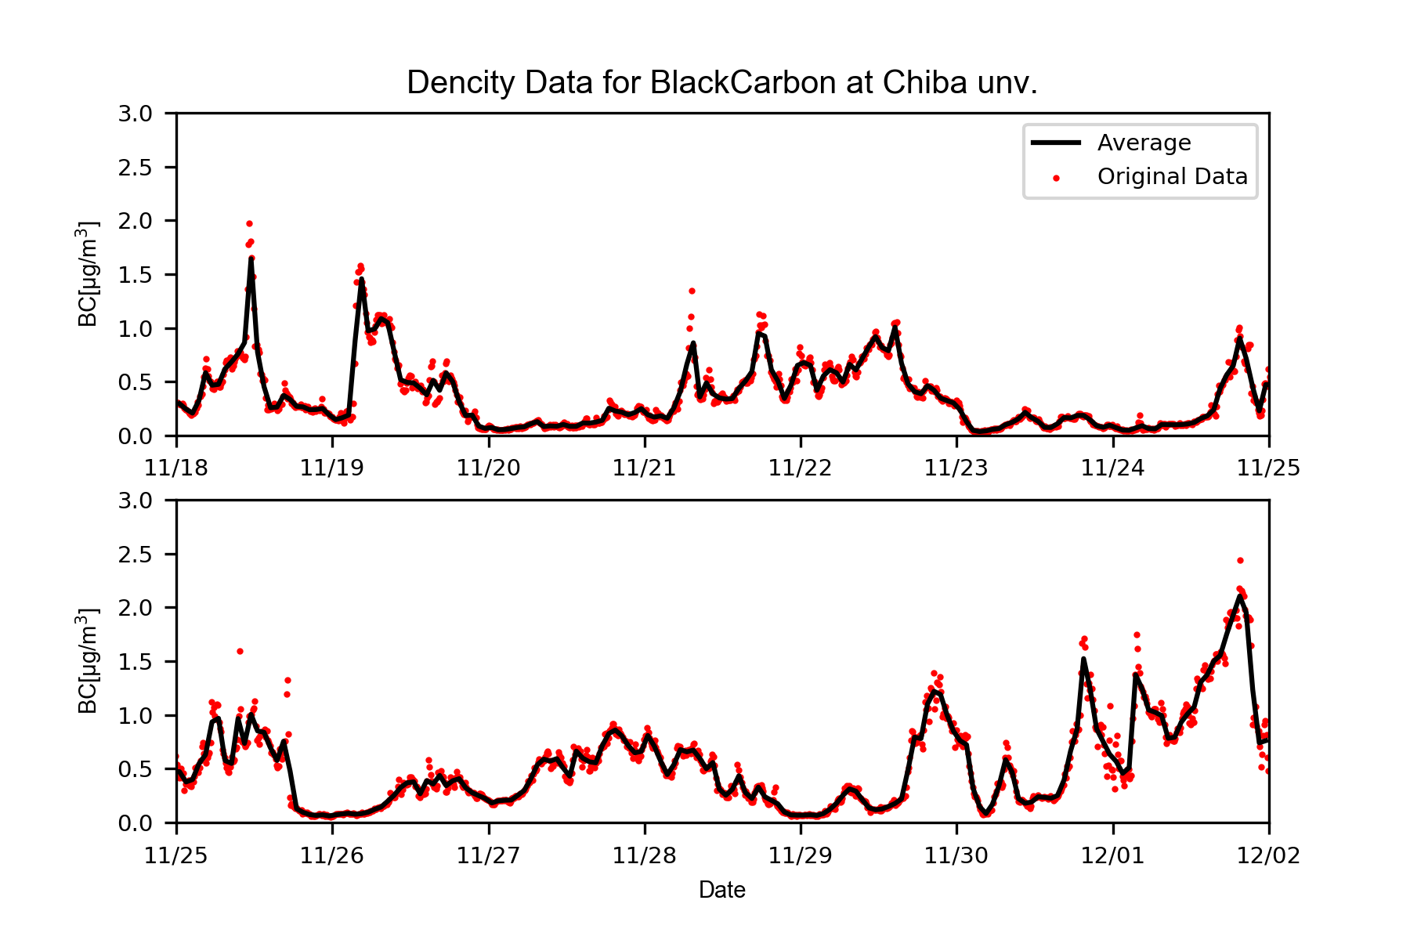
Ⅲ
[Figure] The average of dencity data for Black Carbon per hour and the original data for Black Carbon dencity per seconds (2019/11/18 0:00 ー 2019/12/2 24:00) at Chiba university(35.625N, 140,104E, 60.0m asl)

Slide 7
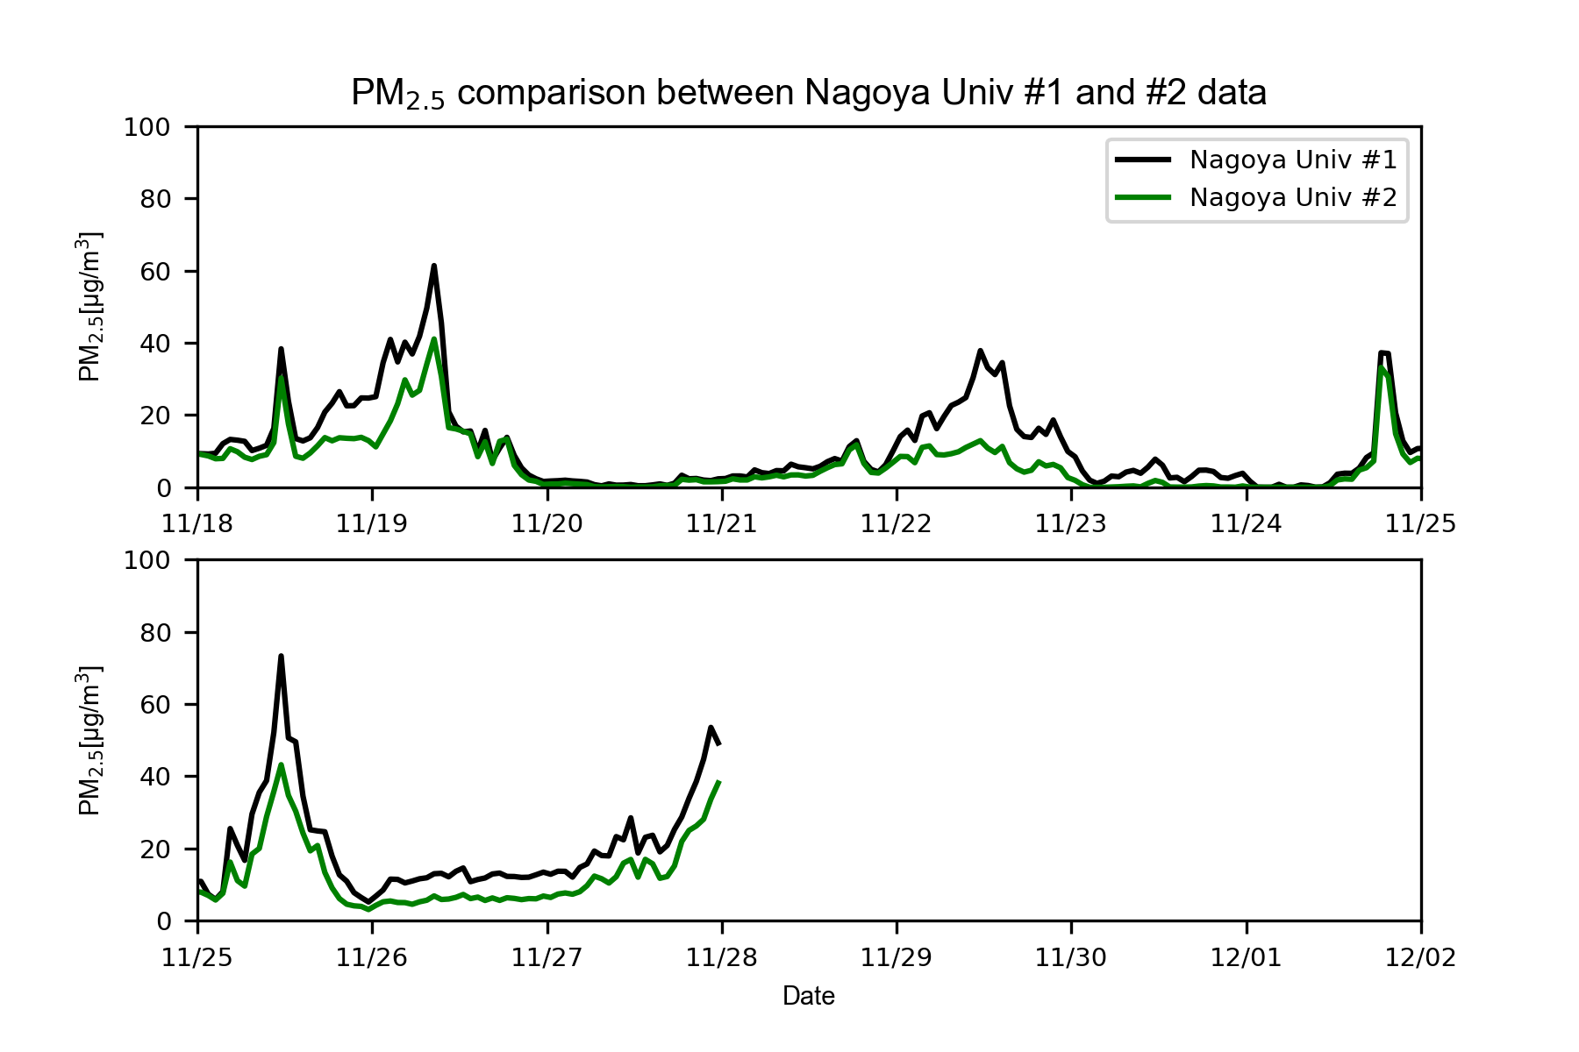
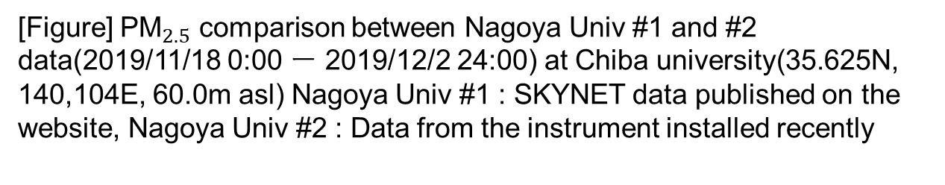
Ⅳ
[Figure] ${\text{PM}}_{2.5}$ comparison between Nagoya Univ #1 and #2 data(2019/11/18 0:00 ー 2019/12/2 24:00) at Chiba university(35.625N, 140,104E, 60.0m asl) Nagoya Univ #1 : SKYNET data published on the website, Nagoya Univ #2 : Data from the instrument installed recently

Slide 8
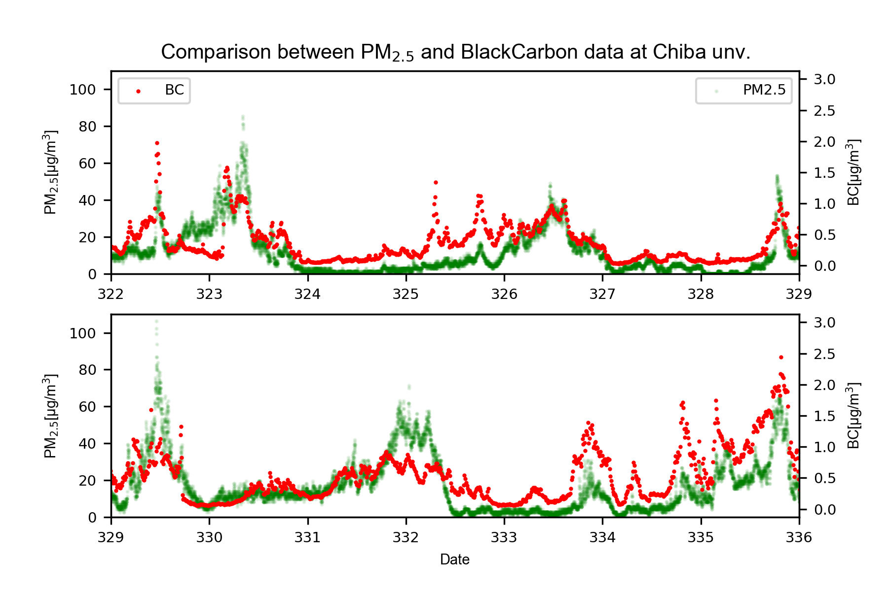
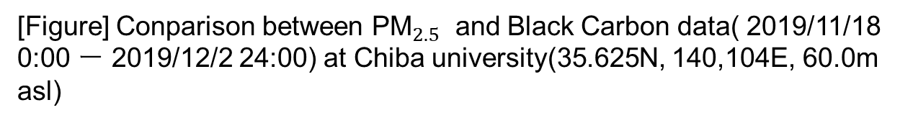
Ⅴ
[Figure] Conparison between ${\text{PM}}_{2.5}$ and Black Carbon data( 2019/11/18 0:00 ー 2019/12/2 24:00) at Chiba university(35.625N, 140,104E, 60.0m asl)

Slide 9
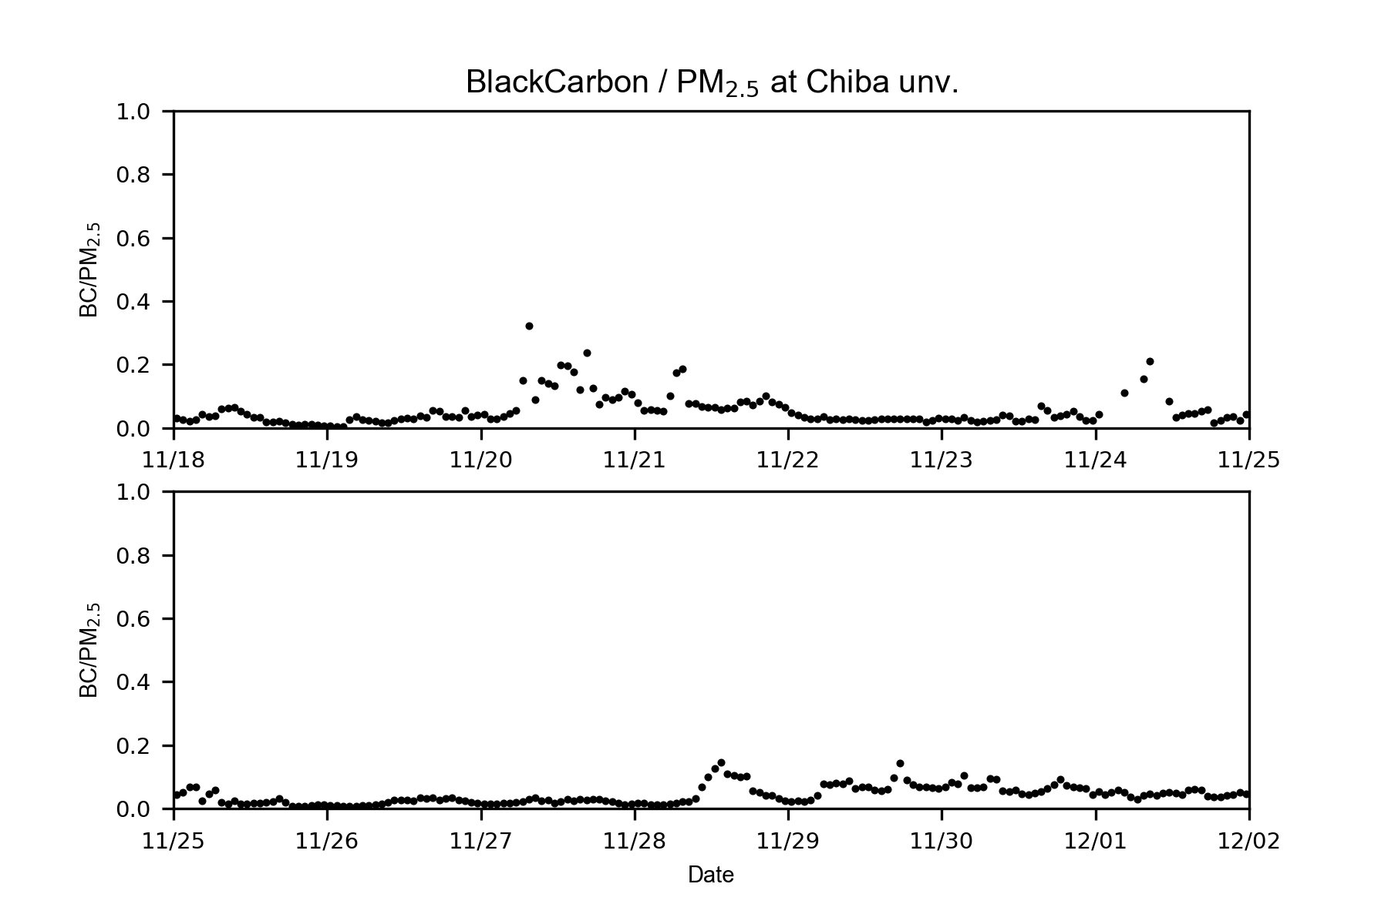
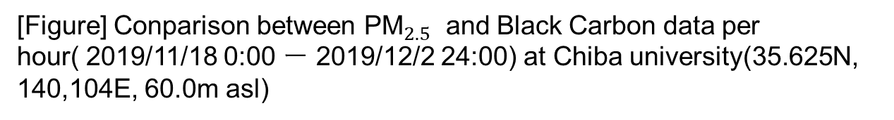
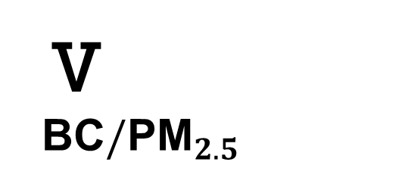
Ⅴ
BC$/{\text{PM}}_{2.5}$
[Figure] Conparison between ${\text{PM}}_{2.5}$ and Black Carbon data per hour( 2019/11/18 0:00 ー 2019/12/2 24:00) at Chiba university(35.625N, 140,104E, 60.0m asl)

